Slide 1
Useless Machine, Useful Application
108062103 莊鈞堯
108062304 黃子軒

Slide 2
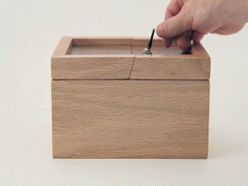
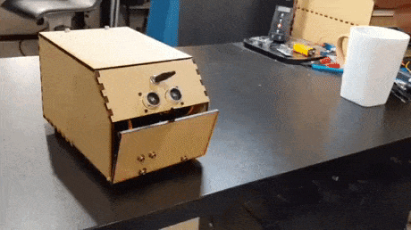
What Is Useless Machine?
Useless Machine is a useless thing that makes you angry.
Usually, it is a box with a switch, so we also call it “useless box.”
When you try to touch the switch, the machine tries its best to trick you.
The following pictures are some examples of useless machines.

Slide 3
What Is Useful Application?
Classic useless machines only make people angry, so we try to make it useful.
However, we still want to keep the features of classic useless machines.
We also added some more unique gameplays.
Therefore, we designed 3 modes for this useless machine:
1. Normal Switch (NS)
2. Useless Box (UB)
3. Useful Car (UC)
See more details in Hardware/Software Design Goals.

Slide 4
1. Normal Switch (NS)
Features
You can control the switch with a Smartphone app.
If you do so, the machine will toggle the switch by itself.
In addtion, if you try to toggle the switch with your bare hands, then the machine will not trick you but act like a normal switch.
The switch is able to connect to an external device, so you can control the device with the switch .

Slide 5
2. Useless Box (UB)
Features
You can decide what kind of useless box you want to play with.
3 different boxes you may choose:
Classic, Dodge, or Advanced.
If no choices were made, we will give you a random sequence of all modes.
Don’t be greedy! You will see “Err” on 7-segment display if you choose more than 1 useless box, and of course, it won’t play with you.

Slide 6
2.1 Classic Mode
Features
The box pushes the switch back once you toggle the switch.
Most useless boxes are dangerous because the flipping arms may hurt you when it tries to toggle the switch but your hands are still there.
Don’t worry! We have IR sensors detecting whether your hands are close or not, so the box will push it back only when your hands leave.

Slide 7
2.2 Dodge Mode
Features
The box runs away when you try to touch the switch.
In most situations, the box will go to the opposite side.
It runs for about 3 seconds and then stops.

Slide 8
2.3 Advanced Mode
Features
The box competes with you for toggling the switch.
Advanced Mode is only recommended for high-level players.
Competition means that it is dangerous because the box won’t let you win, even if your hands are still there.
Note that the safe method in 2.1 is still applied here, but it will work only when the box wants to push the switch back after the competition ends.

Slide 9
3. Useful Car (UC)
Features
It becomes a car that can be remotely controlled by the Smartphone app.
You can let the car go Forward, Backward, Left or Right.
When left or right is chosen, the car stay there and change direction, so it won’t go forward or backward at the same time.
You can still toggle the switch with the Smartphone app in this mode.
Also, the classic mode and the safety measure of the useless box still function.

Slide 10
4. How To Change Mode?
1. Mode can be changed with a pushbutton (btnC) or Smartphone app, and the current mode will show on 7-segment display (NS = 0, UB = 1, UC = 2.)
2. Use sw0～sw2 to change the useless box you want in UB mode, and LED will show what kind of useless box you want.
3. Have Fun!

Slide 11
Software Design Goals
1. Achieve great user experience with both useless and useful functions.
2. Appropriate algorithms to ensure every function works well.
3. Proper safety system that allows user to play with the machine without risk.
4. Apparent, clear, and beautiful UI to display current mode and error message.
5. Provide easy method for user to operate the machine.
6. Highly readable and good coding style to make maintenance easier.

Slide 12
Appropriate Algorithms
How to design a good distance-detecting algorithm is a serious problem in this module. This important algorithm will strongly influence user experience. However, the ultrasonic sensors and IR sensors may not be sensitive or precise enough. Also, our useless box are not symmetric for left and right.
Our solution to sensor problem is to use both and to do lots of tests for the box, so the parameter in the algorithm can be more accurate.
As for the solution to symmetric problem, we adjust two parameters in the algorithm, “total length” and “delta (length of left side – length of right side),” so that ultrasound sensors can detect the distance between switch and user, not the distance between center of the box and user.

Slide 13
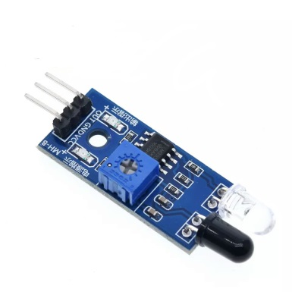
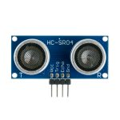
Safety System
With IR sensors being close to the switch, we can easily detect whether the user is nearby or not, and then add an if-else statement to prevent user from being hurt by flipping arms when toggling the switch.
In the dodge mode of the useless box, we not only set a counter and count for about 3 seconds, but also detects the distance from user with ultrasonic sensors. If user isn’t near the box, it will stop running so that unexpected danger can be avoided.

Slide 14

Easy Method To Operate Machine
Basically, we use buttons and switches on FPGA board to change mode and toggle the switch. However, we also provide a easy method for those who don’t know (or forget) how to do these. That is, a special Smartphone app with Bluetooth function.
With this app, user can easily control the useless box, such as changing mode and toggling the switch without using FPGA board. In addition, user can have fun playing with the remote-controlled car in UC mode. More functions were planned to be provided on the app, but due to the lack of time, some functions are not currently supported.

Slide 15
Hardware Design Goals
1. Achieve great user experience with common and low cost components.
2. Stick to the original spec without causing permanent changes to the car provided in class.
3. Arrange sensors for easy hand detection.
4. Provide easy connection to the FPGA board.
5. Can be remotely controlled.
6. Can safely control external devices without putting the FPGA board at risk.

Slide 16
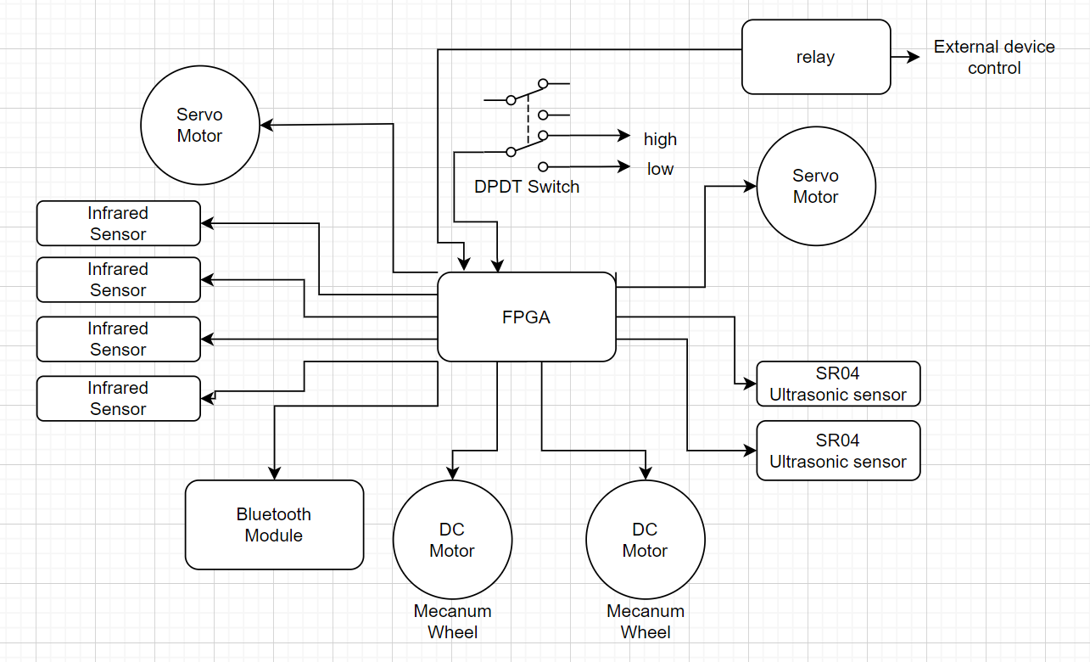
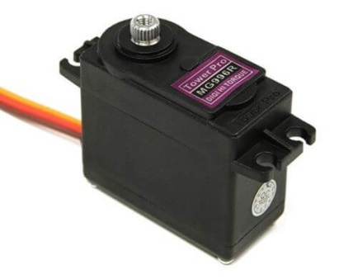
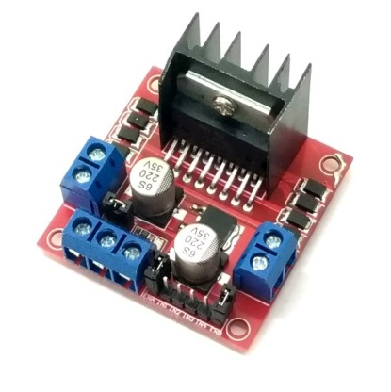
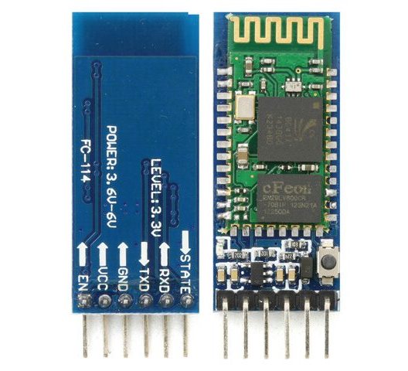
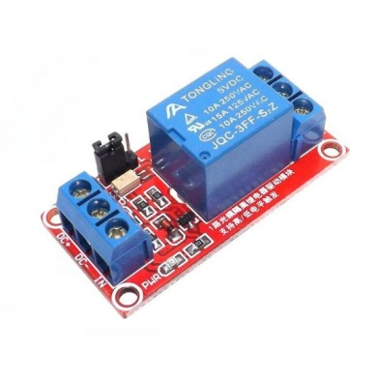
Signal Connections and Component Choice
SR-04
Ultrasonic Sensor
Infrared
Sensor
MG996r
High-Torque
Servo
L298n H-bridge
Motor Driver
Optical-coupled
Relay Module
HC-05 UART
Bluetooth Module

Slide 17
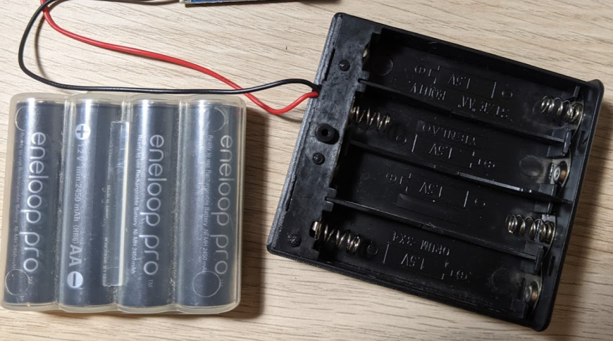
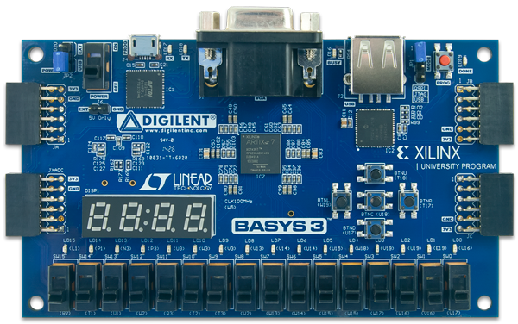
Power Connection
6V
---->
6V
---->
3.3V
---->
Power source:
4x High-current AA batteries
Power Requirements:
FPGA Board: 5v servo motor: 4.8~7.2v
IR sensors: 3~6v DC motor: 5~12v
Ultrasonic seneor: 5v Relay module: 5v
Bluetooth : 3.3v or 5v motor driver: 3.3~7v
All the voltage regulator ICs on Basys3 can withstand well beyond 6V, so it’s safe (unless we want to use the USB A peripheral port).
Difficulties:
The High-Torque Servo can draw up to 2.5A each.
Risk of running components higher than their standard voltage.
It took many iterations and compromises to get the desired result.

Slide 18
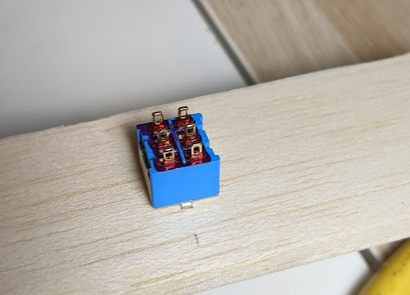
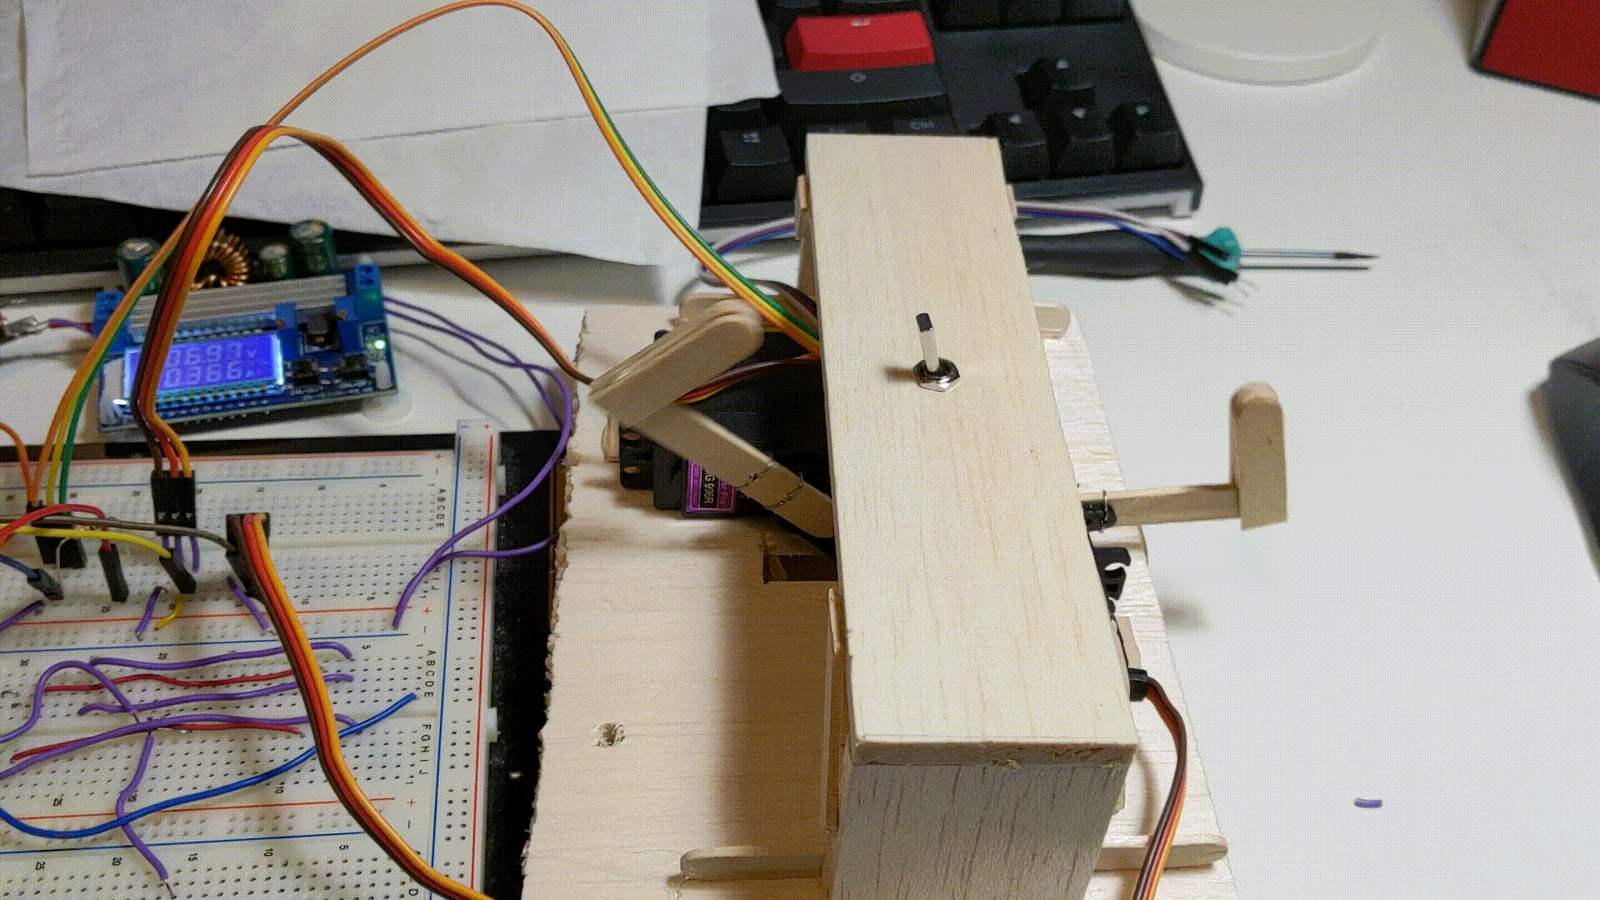
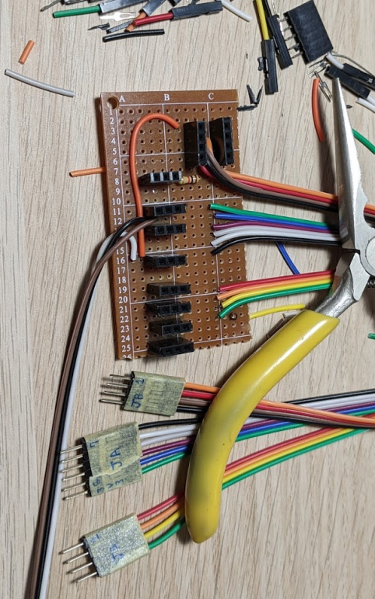
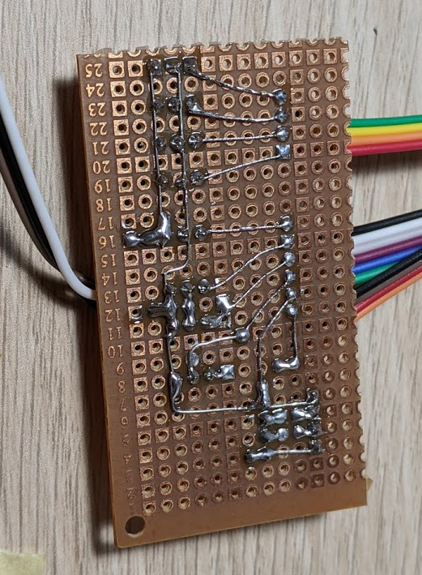
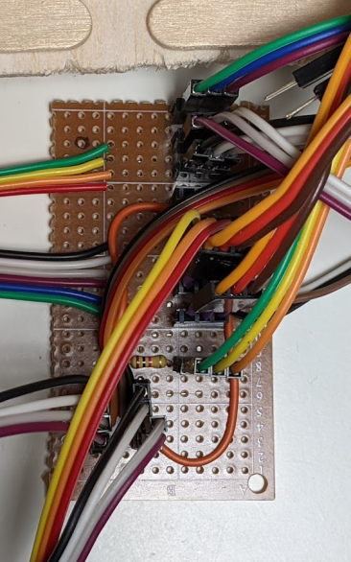
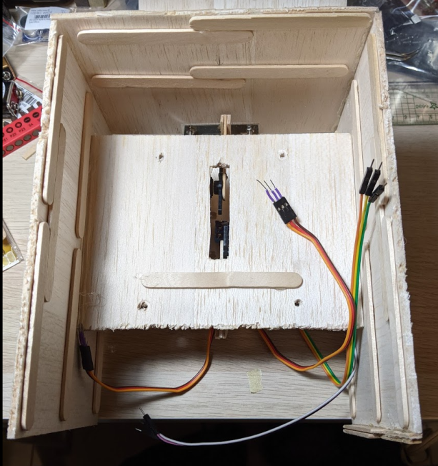
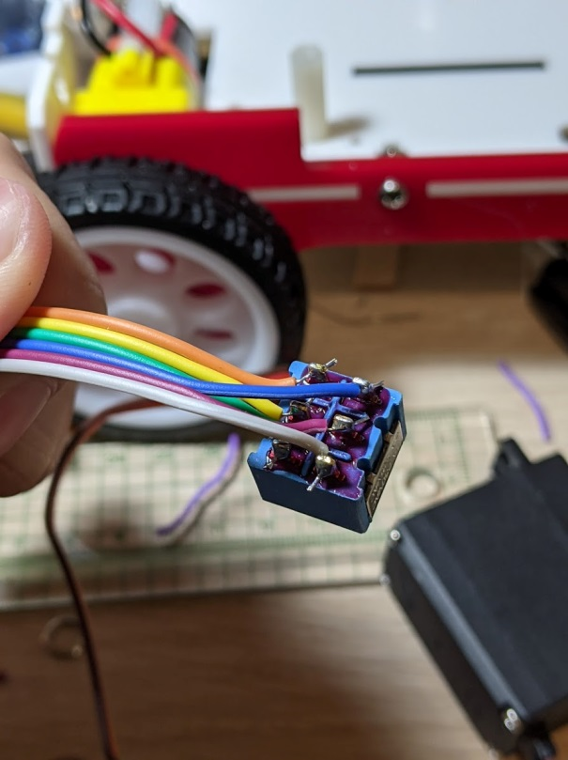
Simplified Connections and Reusable Car
1. Hand Soldered circuit board to handle all power connections and convert all signals to PMOD pinout.
2. FPGA Board can be removed easily removed at any time.
3. All the cable mess is hidden under the box.
4. The wooden box is secured to the car with four standard screws and can be removed without affecting other functions of the machine.

Slide 19
Responsibility
108062103 莊鈞堯
Hardware design , build and maintenance.
Bluetooth connection and smartphone App.
Verilog modules to communicate with external devices.
108062304 黃子軒
State machine design and debug.
Top Verilog module design.
Design player detection algorithms with existing sensors.
ALL
PowerPoint.
System test.
Debug.

Slide 20
Thank You For Your Listening!

